Slide 1

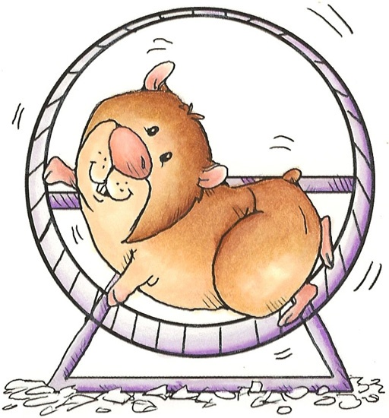
Home Not So Alone
Home Alone

